Slide 1
HOUSE PRICE PREDICTION
Amritesh Kumar
Jan 2022

Slide 2
Problem Overview
US-based housing company named Surprise Housing has decided to enter the Australian market.
Company uses data analytics to purchase houses at a price below their actual values & flip them at a higher price. For the same purpose, the company has collected a data set from the sale of houses in Australia.
You are required to build a model using Machine Learning in order to predict the actual value of the prospective properties and decide whether to invest in them or not.
For this company wants to know:
Which variables are important to predict the price of variable?
How do these variables describe the price of the house?

Slide 3
Conceptual Background of the Domain Problem
MACHINE LEARNING AND DATA SCIENCE FOR BUSINESS:
Machine learning is a branch of artificial intelligence (AI) & computer science focusing on the use of data & algorithms to imitate the way that humans learn from experience, make predictions and gradually improving its accuracy. It is an important component of the growing field of data science.
Through the use of statistical methods, algorithms are trained to make classifications or predictions, uncovering key insights within data mining projects. These insights subsequently drive decision making within applications and businesses, ideally impacting key growth metrics.
As big data continues to expand and grow, the market demand for data science will increase, requires to assist in the identification of the most relevant business questions and subsequently the data to answer them. Following are the ways Data science can add value to Business :
• Empowering management and officers to make better decision
• Directing actions based on trends—which in turn help to define goals
• Challenging the staff to adopt best practices and focus on issues that matter
• Identifying opportunities
• Decision making with quantifiable, data-driven evidence
• Testing these decisions
• Identification and refining of target audiences

Slide 4
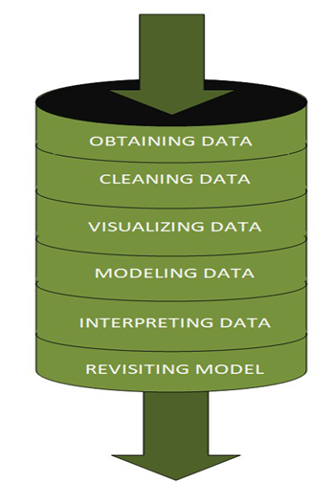
DATASCIENCE PIPELINE:
The data science pipeline is a collection of connected tasks that aims at delivering an insightful data science product or service to the business organization.
The responsibilities include collecting, cleaning, exploring, modeling, interpreting the data, and other processes of the launching of the product.
“This final product can be used for to achieve Business Goals”
Exploratory Data Analysis (EDA) & IT’s TYPES:
The main purpose of EDA is to help look at data before making any assumptions.
It can help identify obvious errors, as well as better understand patterns within the data, detect outliers or anomalous events, find interesting relations among the variables.
Data scientists can use exploratory analysis to ensure the results they produce are valid and applicable to any desired business outcomes and goals.
EDA also helps stakeholders by confirming they are asking the right questions
TYPES OF EXPLORATORY DATA ANALYSIS:
Univariate Non-graphical
Multivariate Non-graphical
Univariate graphical
Multivariate graphical

Slide 5
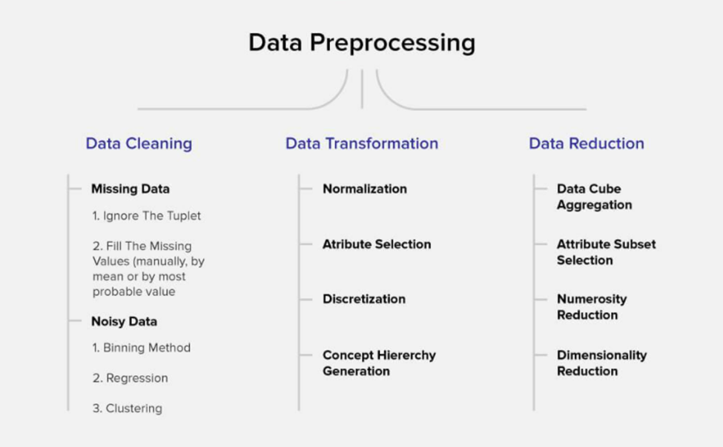
DATA PRE-PROCESSING
Data pre-processing is a very vital input to machine learning models, It is to prepare the raw data & make it suitable for efficient machine learning model. These are the methods of data pre-processing and we are going to use the required ones in our project.

Slide 6
FEATURE ENGINEERING
Feature engineering is the process of selecting, manipulating & transforming raw data into features that can be used in supervised learning. In simple terms, is the act of converting raw observations into desired features using statistical or machine learning approaches. It can produce new features for both supervised and unsupervised learning, with the goal of simplifying and speeding up data transformations while also enhancing model accuracy
Techniques Used,
Imputation
Handling Outliers
Log Transform
One-hot encoding/Label Encoding
Scaling
Data Transformation:
Label Encoding:
In library installation, Label Encoder is used to encode labels by assigning them numbers. It is used to encode single or multiple columns. Thus, if the feature is color with values such as [‘white’, ‘red’, ‘black’, ‘blue’]., using Label Encoder may encode color string label as [0, 1, 2, 3]
Handling Outliers:
This is the most important phase in handling outliers because it ensures that our model is trained on accurate data which leads to accurate models. An outlier may occur due to the variability in the data. It may indicate an experimental error or heavy skewness in the data(heavy-tailed distribution). We have three measures of central tendency namely Mean, Median, and Mode. They help us describe the data.
Below are some of the techniques of detecting outliers
• Box-plots
• Z-score

Slide 7
FEATURE ENGINEERING
SKEWNESS REMOVAL-(POWER-TRANSFORM):
Power transform will make the probability distribution of a variable more Gaussian.
This is often described as removing a skew in the distribution, although more generally is described as stabilizing the variance of the distribution. The power-transform library present in the Sklearn, Pre-processing package.
MINMAX SCALER:
MinMax Scaler shrinks the data within the given range, usually of 0 to 1. It scales the values to a specific value range without changing the shape of the original distribution. Before scaling we have to train test split the data, Since we have to do skewness removal and scaling only on input data.
TRAIN TEST SPLIT:
The scikit-learn Python machine learning library provides an implementation of the train-test split evaluation procedure via the train_test_split() function. The function takes a loaded dataset as input and returns the dataset split into two subsets. train_test_split() will split arrays data into random subsets. The ideal split is said to be 80:20 for training and testing.

Slide 8
Review of Literature
ABSTRACT:
In this House Price Prediction Project, we are going to predict the price of the houses in Australia with collection records of the sale of houses in Australia. We are doing this prediction for the US-based housing company named Surprise Housing. This company has decided to enter the Australian market to purchase houses at a price below their actual values and flip them at a higher price. So our detailed analysis, Machine Learning Model predictions done can be used for specific Business Requirements, Challenges and Improvements of the d Surprise Housing Company.
Business Goal:
Model the price of houses with the available independent variables. This model will then be used by the management to understand how exactly the prices vary with the variables. They can accordingly manipulate the strategy of the firm and concentrate on areas that will yield high returns. Further, the model will be a good way for the management to understand the pricing dynamics of a new market.

Slide 9
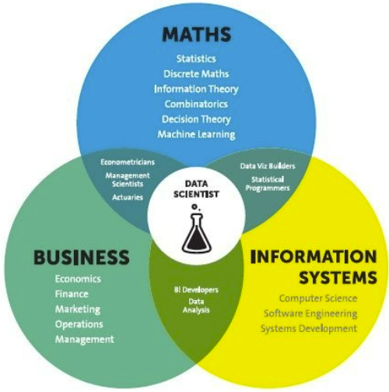
Analytical Problem Framing
Mathematical / Statistical / Analytical Modeling - are three of the most important concepts of Data Science. Data Science revolves around these three fields and draws their concepts to operate on the data.
Mathematical Modelling
Mathematical models are important, selecting the right one to answer the business question can bring tremendous value to the organization. It plays an essential role in the latest technologies like Machine Learning, Artificial Intelligence, Data Science and Deep Learning, etc., It is because every algorithm built in the latest technologies has a mathematical function behind it and aid in identifying patterns
The understanding of various notions of Statistics and Probability Theory are key for the implementation of such algorithms in data science.
Notions include: Regression, Maximum Likelihood Estimation, the understanding of distributions (Binomial, Bernoulli, Gaussian (Normal)) and Bayes’ Theorem
The main reason for a greater significance of mathematics is because of its various concepts like: –
Linear Algebra
Probability
Calculus – Differential & Integral Calculus
Statistics
Descriptive (Mean, Median, Mode, IQR, Std. deviation, Z & T- Statistics, linear regression)
Inferential (Sampling, Confidence interval, chi-square, ANOVA)

Slide 10
Analytical Problem Framing
Regression Models:
Data analysts use regression models to examine relationships between variables. Regression models are often used by organizations to determine which independent variables hold the most influence over dependent variables—information that can be leveraged to make essential business decisions
Classification Models:
Classification is a process in which an algorithm is used to analyze an existing data set of known points. The understanding achieved through that analysis is then leveraged as a means of appropriately classifying the data. Classification is a form of machine learning that can be particularly helpful in analyzing very large, complex sets of data to help make more accurate predictions.

Slide 11
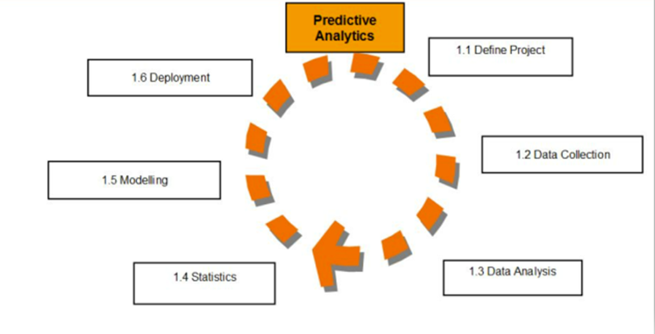
Analytical Models:
An analytical model is quantitative in nature, and used to answer a
specific question or make a specific design decision.
Different analytical models are used to address different aspects
of the system, such as its performance, reliability,
or mass properties. Data analysis comes with the fundamental
types of data analytics encounter in data science: Descriptive,
Diagnostic, Predictive, and Prescriptive.
Descriptive analytics is a statistical method that is used to search and
summarize historical data in order to identify patterns or meaning.
Descriptive analysis is often used when reviewing any past or present data. This is because raw data is difficult to consume and interpret, while the metrics offered by descriptive analysis are much more focused.
The example of descriptive statistics or analytics is to calculate the mean, median mode, standard deviation, and similar kinds of statistical calculation on finance or sales data.
Diagnostic analytics takes it a step further to uncover the reasoning behind certain results. Diagnostic analytics is usually performed using such techniques as data discovery, drill-down, data mining, and different type of bi-variant data analysis like correlations. etc.,
Predictive Analytics is a statistical method that utilizes algorithms and machine learning to identify trends in data and predict future behaviors. Predictive Analytics can take both past and current data and offer predictions of what could happen in the future.
Predictive models typically utilize variability in data to make the correct prediction and more variability of ingredient data that shows the relationship with what is possible to predict that united together into a prediction or valid score.
Prescriptive analytics automatically synthesizes big data, mathematical sciences, business rules, algorithms, and machine learning to make predictions and then suggests decision options to take advantage of the predictions. Prescriptive means (optimization and simulation).

Slide 12

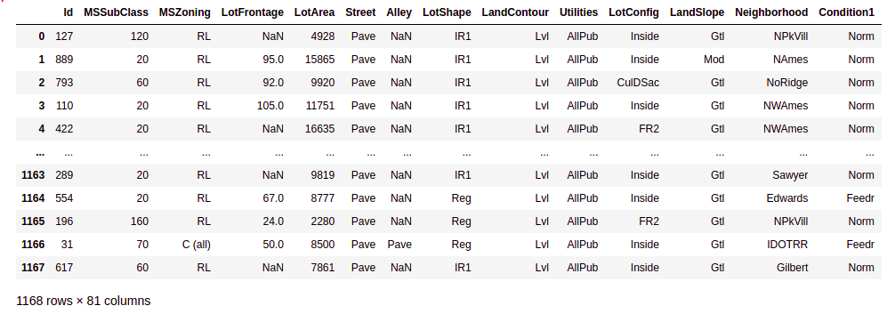
Data Sources and their formats
Technical Requirements:
• Data contains 1460 entries each having 81 variables. Data file is in .csv format.
• We built Machine Learning models, applied regularization and determined the optimal values of Hyper Parameters.
• We found important features which affect the price positively or negatively.
• Two datasets are provided (test.csv, train.csv). We had done training on train.csv dataset and prediction on test.csv file
FEATURE DESCRIPTION:
There are columns which has categorical ordinal data type.
There are columns which has categorical nominal data type.
Here Our Target column is the SalePrice column which is we are going to predict. Hence our problem is the Regression.

Slide 13
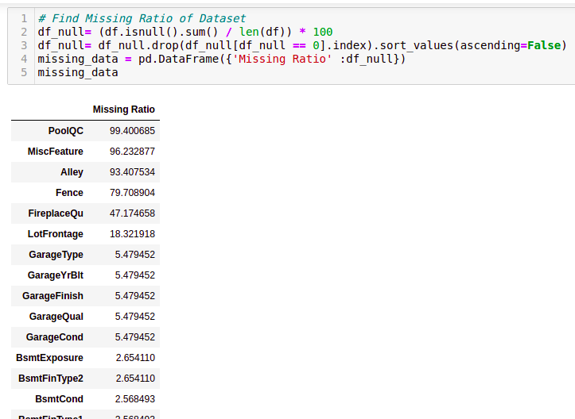
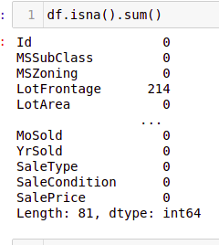
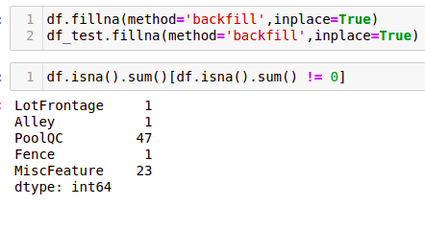

Data Preprocessing

Slide 14
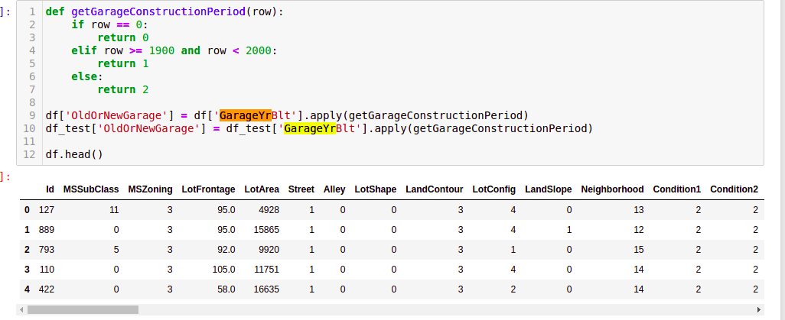
Chanign GarageYrBlt

Slide 15
Data Inputs- Logic- Output Relationships
If y represents the dependent variable and x the independent variable, this relationship is described as the regression of y on x. Regression equation.
Linear regression attempts to model the relationship between two variables by fitting a linear equation to observed data. ... A linear regression line has an equation of the form Y = a + bX, where X is the explanatory variable and Y is the dependent variable.
The output variable (also called dependent variable, or regress and) is assumed to be a linear function of the input variables (also called independent variables, or regressors) and of an unobservable error term that adds noise to the linear relationship between inputs and outputs.
To do this a line is created that best fits a set of data pairs. The value of y is derived through the value of x, reflects their correlation
The RESPONSE of a system is linear when the output is directly proportional to the input, that is, any change in the input produces a proportional change in the output. When plotted on a graph, a straight line results.
Correlation describes the relationship between two sets of data.
Multiple linear regression is a regression model that estimates the relationship between a quantitative dependent variable and two or more independent variables using a straight line. In multiple regression, there are multiple independent variables that enable us to estimate the dependent variable y.
Multiple regression equation is derived by:
Y = a + b1*1 + b2*2 + b3*3……………. bk*k, Here, y is an independent variables whereas b1, b2 and bk
Multiple linear regression attempts to model the relationship between two or more features and a response by fitting a linear equation to observed data.
In Multiple Linear Regression, a Residual is the Difference Between Estimated Dependent Variables and Actual Dependent Variables. Multiple linear regression assumes that the remaining variables’ error is similar at each point of the linear model. This is known as homoscedasticity. When the data analysis is done, the standard residuals against the predicted values are plotted to determine if the points are properly distributed across independent variables’ values. Larger residuals indicate that the regression line is a poor fit for the data, i.e. the actual data points do not fall close to the regression line. Smaller residuals indicate that the regression line fits the data better, i.e. the actual data points fall close to the regression line.

Slide 16
Data Inputs- Logic- Output Relationships
The coefficient of determination (R-squared) is a statistical metric that is used to measure how much of the variation in outcome can be explained by the variation in the independent variables. R2 always increases as more predictors are added to the MLR model, even though the predictors may not be related to the outcome variable.
Multiple linear regression (MLR) is used to determine a mathematical relationship among several random variables.
In a multiple linear regression, the model calculates the line of best fit that minimizes the variances of each of the variables included as it relates to the dependent variable. Because it fits a line, it is a linear model.
The relationship can also be non-linear, and the dependent and independent variables will not follow a straight line. Linear and non-linear regression are used to track a response using two or more variables.
Assuming a linear relation in population, mean of Y for given X equals α+βX i.e. the "population regression line". If Y = a + bX is the estimated line, then the fitted Ŷi = a + bXi is called the fitted (or predicted) value, and Yi Ŷi is called the residual.
The regression coefficient of y on x is represented by b yx and x on y as b xy. Both of the regression coefficients must have the same sign. If b yx is positive, bxy will also be positive and it is true for vice versa. If one regression coefficient is greater than unity, then others will be lesser than unity.
For a bivariate data (Xi, Yi), the relationship may be Y depends on X or X depends on Y. If Y depends on X then the regression line is Y on X. Y is dependent variable and X is independent variable. If X depends on Y, then regression line is X on Y and X is dependent variable and Y is independent variable.
State the set of assumptions (if any) related to the problem under consideration

Slide 17
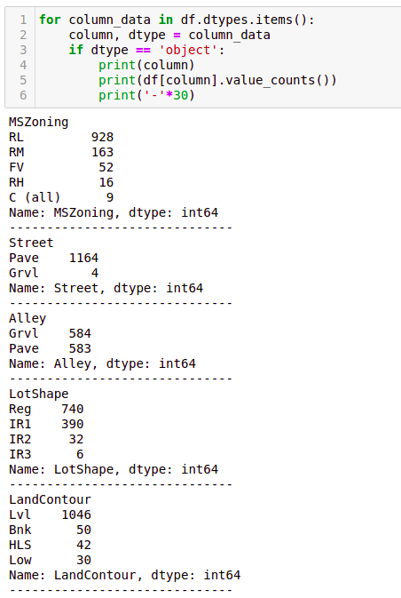
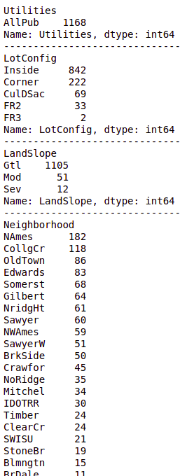
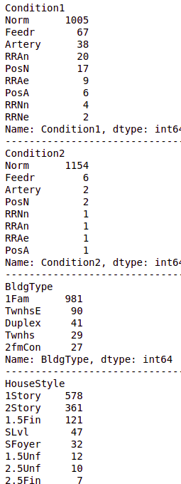
Data Pre-processing & Feature Engineering

Slide 18
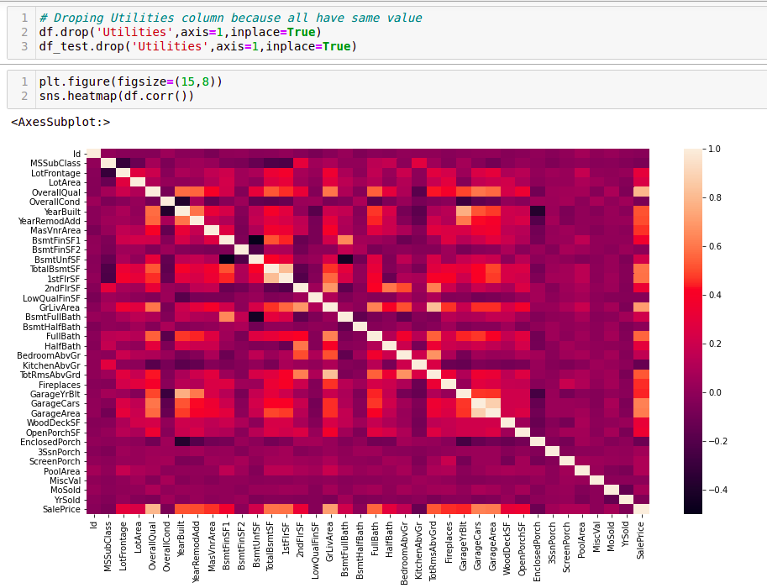
Correlation with Heat-map:
The correlation coefficient is a statistical measure of the strength of the relationship between the relative movements of two variables. The values range between -1.0 and 1.0. A calculated number greater than 1.0 or less than -1.0 means that there was an error in the correlation measurement. A correlation of -1.0 shows a perfect negative correlation, while a correlation of 1.0 shows a perfect positive correlation. A correlation of 0.0 shows no linear relationship between the movement of the two variables. Correlation statistics can be used in finance and investing. Pearson correlation is the one most commonly used in statistics. This measures the strength and direction of a linear relationship between two variables.
It can also be defined as the measure of dependence between two different variables. If there are multiple variables and the goal is to find correlation between all of these variables and store them using appropriate data structure, the matrix data structure is used. Such matrix is called as correlation matrix.
Correlation heatmap is graphical representation of correlation matrix representing correlation between different variables.
To do feature selection and make feature ready for the model building. we check correlation of variables using heatmap. And describe method for the census data set

Slide 19
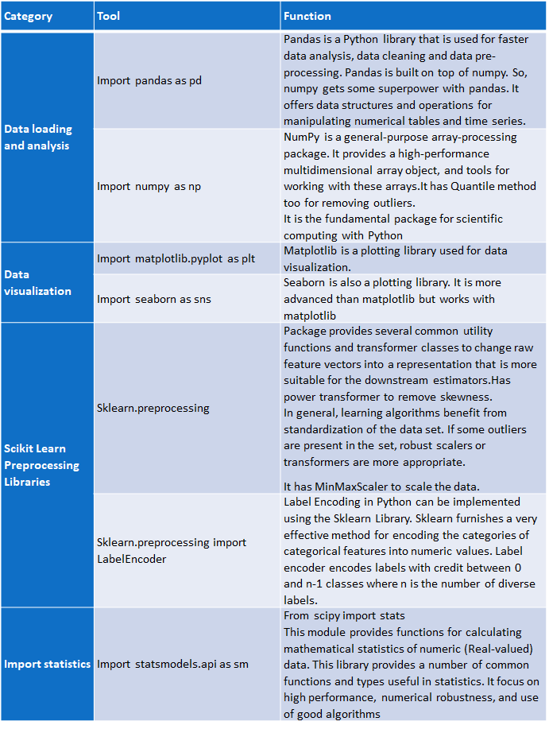
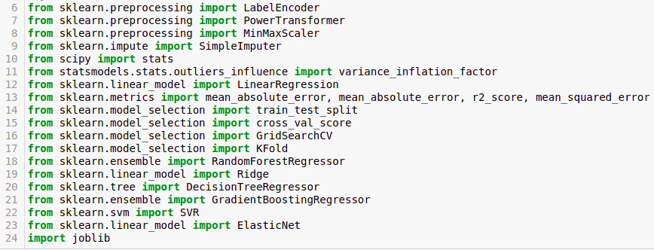
HARDWARE & SOFTWARE TOOLS, LIBRARIES & PACKAGES USED:
Hardware :Intel i7,RAM 16GB used.
Software: Jupyter Notebook (Anaconda 3)
Language: Python
Libraries:
Pandas
Numpy
Matplotlib
Seaborn
Sklean
Scipy
Statsmodels
Pip-Package install Manager

Slide 20
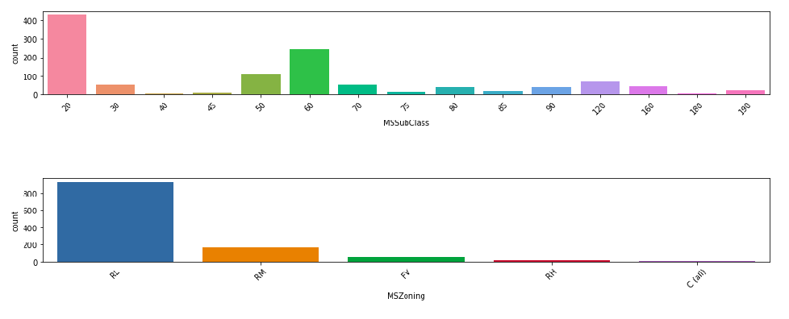
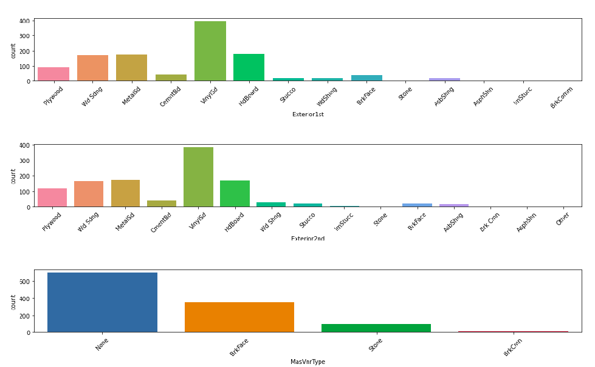
Data Visualation

Slide 21
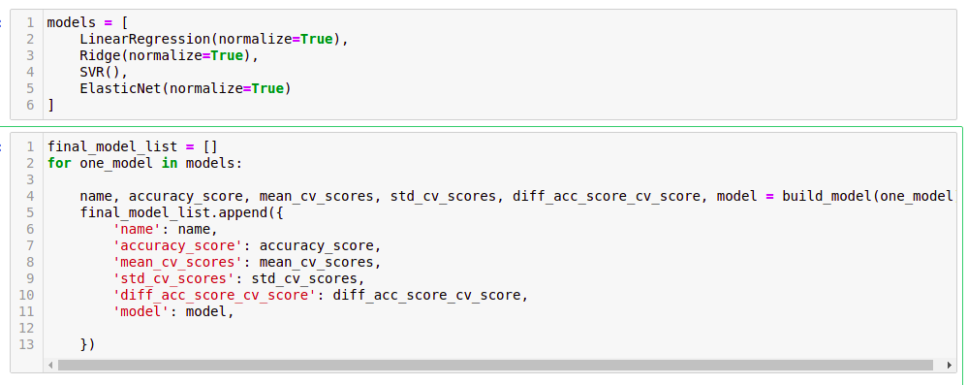
Model/s Development and Evaluation

Slide 22
Testing of Identified Approaches (Algorithms)
These are all the Algorithms used for Model Building and Prediction. We did Hyper Parameter Tuning with these algorithms using the GridSearchCV.
Ridge Regressor
LinearRegression
Support Vector Regressor
ElasticNet Regression
These algorithms has been used for both Training and Testing purpose and got evaluated with r2 score.And also the predicted result got Evaluated with Key Metrics.

Slide 23
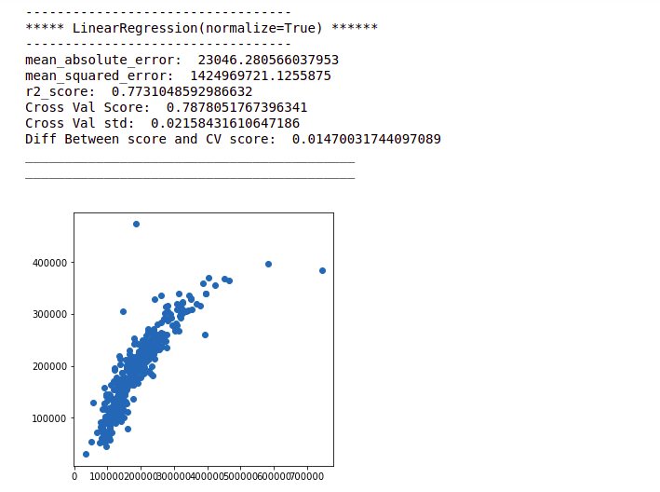
MODEL PREDICTION AND EVALUATION
Linear Regression:
It performs a regression task. Regression models a target prediction value based on independent variables & is mostly used for finding out the relationship between variables and forecasting.
In linear regression, the observations (red) are assumed to be the result of random deviations (green) from an underlying relationship (blue) between a dependent variable (y) and an independent variable (x).

Slide 24
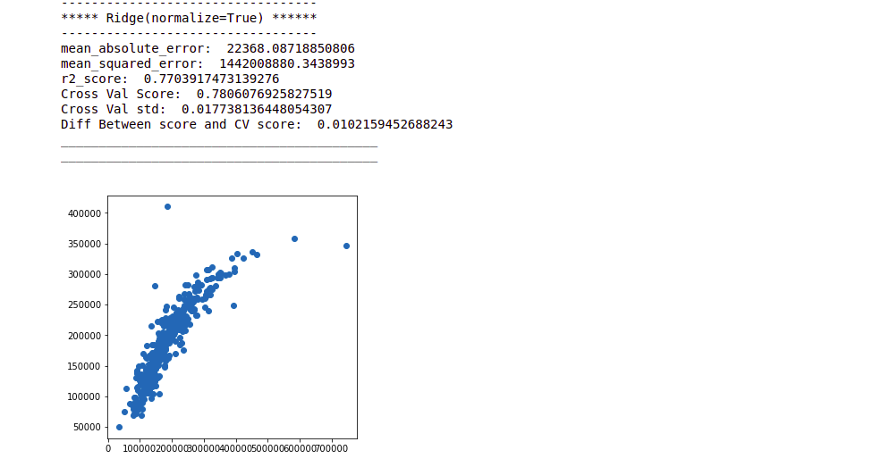
Ridge Regression:
Ridge regression is a technique which is specialized to analyze multiple regression data which is multicollinearity in nature.
Ridge regression is a model tuning method that is used to analyse any data that suffers from multicollinearity. This method performs L2 regularization. When the issue of multicollinearity occurs, least-squares are unbiased, and variances are large, this results in predicted values to be far away from the actual values.
The biggest benefit of ridge regression is its ability to produce a lower test mean squared error (MSE) compared to least squares regression when multicollinearity is present.

Slide 25
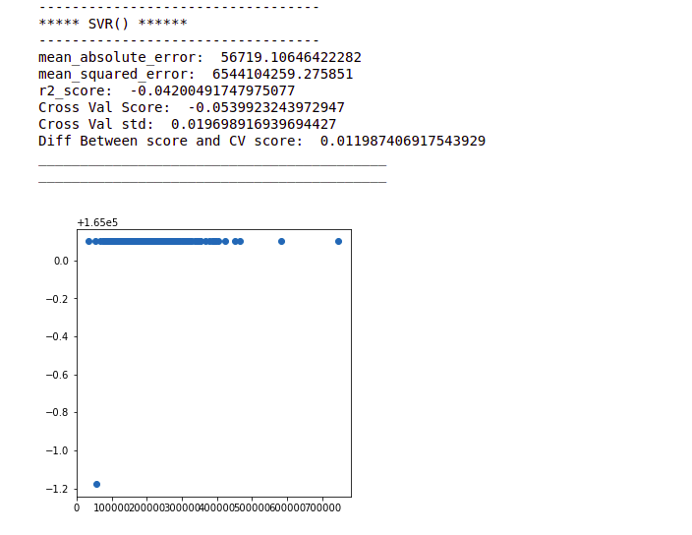
SUPPORT VECTOR REGRESSOR
Support Vector Machine is a discriminative algorithm that tries to find the optimal hyperplane that distinctly classifies the data points in N-dimensional space(N - the number of features). In a 2D space, a hyperplane is a line that optimally divides the data points into two different classes. In a higher-dimensional space, the hyperplane would have a different shape rather than a line.
Support Vector Regression (SVR) is quite different than other Regression models. It uses the Support Vector Machine (SVM, a classification algorithm) algorithm to predict a continuous variable.

Slide 26
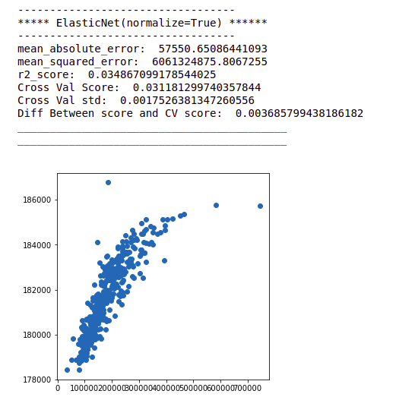
ELASTIC NET REGRESSION(COMBINATION OF L1 AND L2)
Elastic net is a combination of the two most popular regularized variants of linear regression: ridge and lasso. Ridge utilizes an L2 penalty and lasso uses an L1 penalty. With elastic net, you don't have to choose between these two models, because elastic net uses both the L2 and the L1 penalty!
These are all the algorithms used and it described here with the snapshot of their code and the results observed over different evaluation metrics are also mentioned.
The evaluation metrics used here is r2 score.
R2 score:
It is the proportion of the variance in the dependent variable that is predictable from the independent variable(s).” Another definition is “(total variance explained by model) / total variance.” So if it is 100%, the two variables are perfectly correlated, i.e., with no variance at all.
Key Metrics for success in solving problem under consideration
Error addresses exactly this and summarizes on average how close predictions were to their expected values. There are three error metrics that are commonly used for evaluating and reporting the performance of a regression model; they are: Mean Squared Error (MSE). Root Mean Squared Error (RMSE) and Mean Absolute Error(MAE). We got minimum errors in Ridge Regression Model of our project. Because it handles multicollinearity with features well and gives good accuracy with less errors.so we used this metrics.

Slide 27
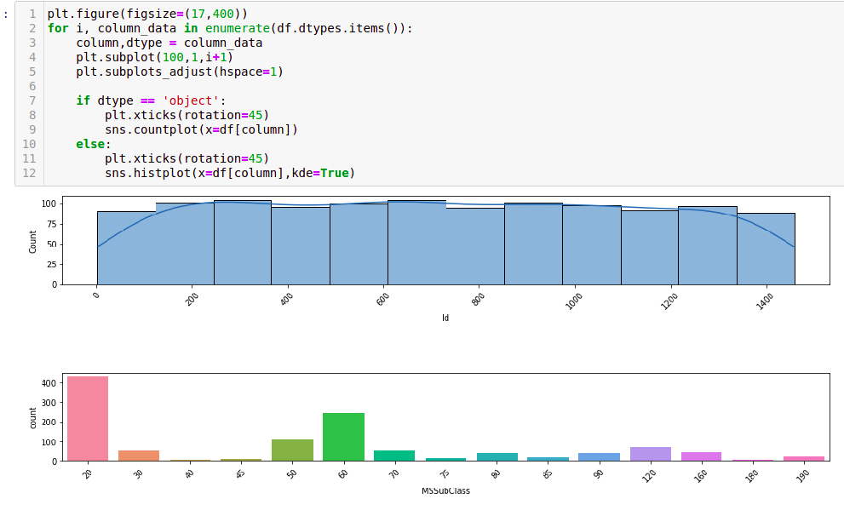
Visualizations

Slide 28
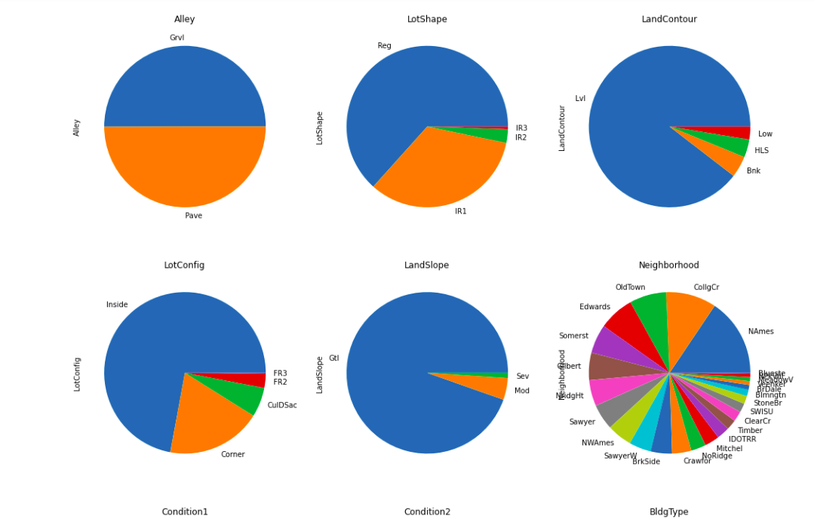
Visualizations

Slide 29
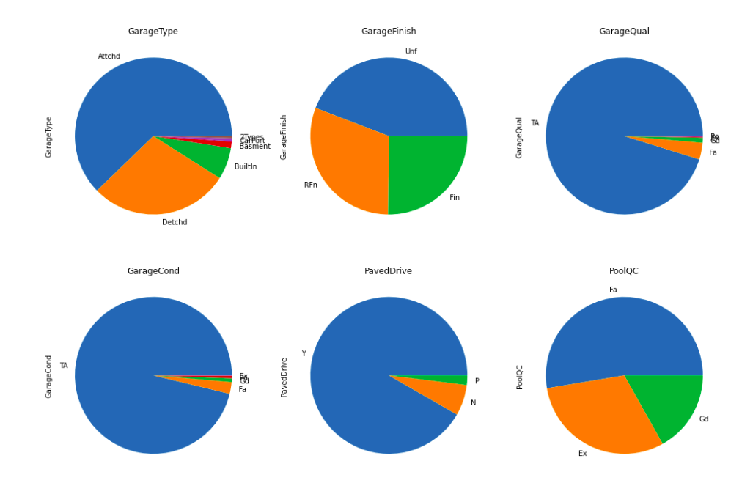
Visualizations

Slide 30
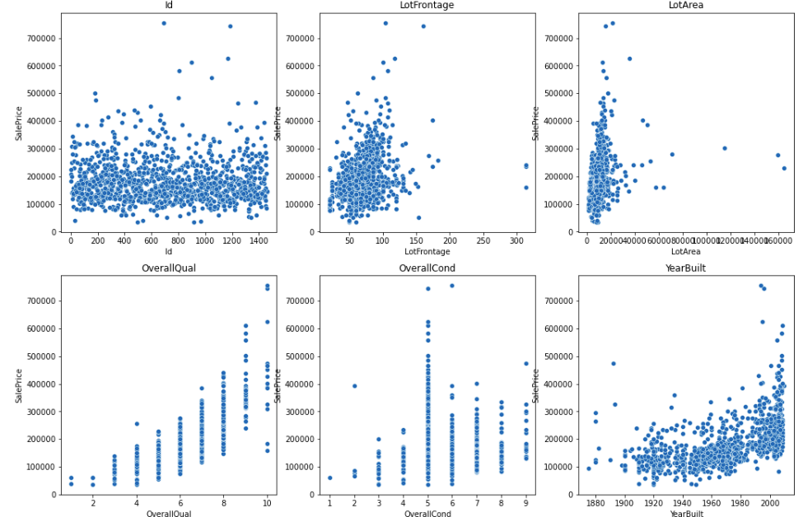
Visualizations

Slide 31
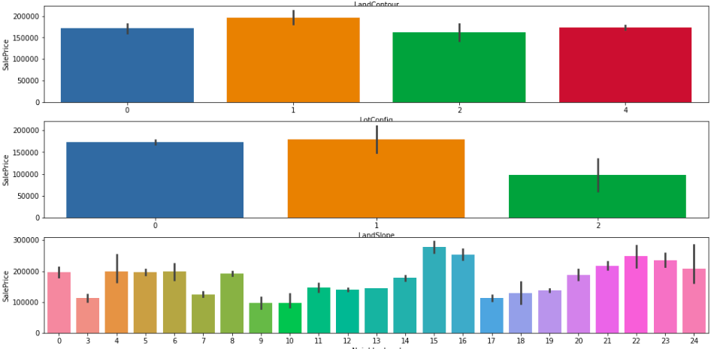
Visualizations

Slide 32
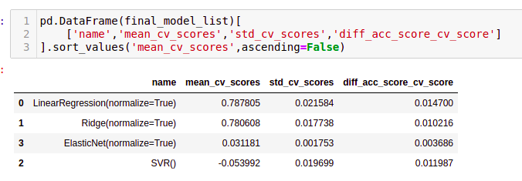
Interpretation of the Results

Slide 33

MODEL SAVING:

Slide 34
CONCLUSION
Key Findings and Conclusions of the Study
Sale price of the house mostly depends on overall condition, sale condition, house zones and types, garage area, lot area, total room above ground, age of the house, remodelled or not, fireplace, Full Bath etc.,
These are the variables are important to predict the price of variable.
These variables describes the price of the house because these depends on environment, people’s living style and needs of Australia.
All Houses are fixed with price depends on the above all prescribed variables only.
Learning Outcomes of the Study in respect of Data Science
From the above models, Ridge Regressor performs well, Because Ridge regression is a model tuning method that is used to analyse any data that suffers from multicollinearity. This method performs L2 regularization. When the issue of multicollinearity occurs, least-squares are unbiased, and variances are large, this results in predicted values to be far away from the actual values.
This is our Best Fit Model. So we save this model for our analysis
We faced multicollinearity because too many features in the dataset. Eventhough the number of features after reduced from 81 to 61.we still face multicollinearity issue.So we used Ridge Regression Model because it handles the problem of multicollinearity very well.
Because to get out of this issue of without completely removing some predictor variables from the model is to use a method known as ridge regression, which instead seeks to minimize the following: where j ranges from 1 to p and λ ≥ 0. This second term in the equation is known as a shrinkage penalty.
To get out of this issue without completely removing some predictor variables from the model is to use a method known as ridge regression, which instead seeks to minimize the following: where j ranges from 1 to p and λ ≥ 0. This second term in the equation is known as a shrinkage penalty.
Thus this Ridge Linear Regression Model performs good so we saved this model

Slide 35
Limitations of this work and Scope for Future Work:
The biggest drawback of ridge regression is its inability to perform variable selection since it includes all predictor variables in the final model.
Since some predictors will get shrunken very close to zero, this can make it hard to interpret the results of the model.
Handling of multicollinearity with more accuracy can improve the model performance to great extent and can predict any kind of similar datasets with more accurate results.

